Slide 1
LAW AND BIOETHICS AND IMPLICIT BIASL
Lost in Translation? Legal and Ethics Challenges Caring for Limited English Proficiency Patients
November 2nd, 2023

Slide 2
Required legal notice:
(some of us are lawyers after all)
Lost in Translation? Legal and Ethics Challenges Caring for Limited English Proficiency Patients
November 2, 2023 6:15-8:15 p.m.
"Information Regarding New York CLE Credits:
Columbia Law School has been certified by the New York State Continuing Legal Education (CLE) Board as an Accredited Provider of CLE programs. Under New York State CLE regulations, this live simultaneous transmission non-transitional CLE Program will provide 1 hour of New York CLE credit in Diversity, Inclusion, & the Elimination of Bias, and 1 hour credit in Areas of Professional Practice. This CLE credit is awarded to New York attorneys for full attendance of the Program in its entirety and no partial credit will be awarded. Attendance is determined by an attorney's submission of their Attorney Attendance Affirmation forms with appropriate course codes noted. On submission of the Attorney Attendance Affirmations, attorneys also should submit their completed Evaluation Form, provided by the program organizers. Please note the NYS Certificates of Attendance will be sent to the email address as it appears in the register unless otherwise noted there."

Slide 3
More Required Legal Notices:
Lost in Translation? Legal and Ethics Challenges Caring for Limited English Proficiency Patients
November 2, 2023 6:15-8:15 p.m.
Presenters:
David N. Hoffman
Andrew Friedman
Jorge Rivera
Tracy Koss
Joyeeta Dastidar
Danurys L. Sanchez
The presenters have no conflicts of interest to disclose.
Opinions expresses by the participants do not represent the positions of their institutions.

Slide 4
AGENDA
1) How did provision of interpretation services become a standard of care issue?
2) The role of advocacy and organizing in changing the conversation about the legal duty to address heath disparities.
3) What legislation has, and has not accomplished. What more can we, and should we do?
4) What is working, and how is it working, the interpreter’s perspective.
5) How does it work, and how is it not working: The Physician/Hospitalist’s perspective.
6) How does the hospitals’ compliance with legal and ethical obligations to provide interpretation and translation services look from the L.E.P. Patient’s perspective
7) Panel Discussion: To what extent, if any, does the ethical obligation of clinicians to communicate effectively with LEP patients need further legal enforcement authority?

Slide 5
LAW AND BIOETHICS AND IMPLICIT BIAS
First things first,
Let’s remind ourselves,
Why are we here?

Slide 6
LAW AND BIOETHICS AND IMPLICIT BIAS
From Nikeeya Alexander:

Slide 7
LAW AND BIOETHICS AND IMPLICIT BIAS
[e]very human being of adult years and sound mind has a right to determine what shall be done with his own body,
Schloendorff v. Society of New York Hospital
211 N. Y. 125, 129-130, 105 N. E. 92, 93 (1914)

Slide 8
LAW AND BIOETHICS AND IMPLICIT BIAS
How did provision of interpretation services become a standard of care issue?
What is the professional ethical obligation of lawyers to educate and advocate regarding the compliance obligation to LEP patients that exists as a part of the standard of care for their healthcare clients?
David N. Hoffman

Slide 9
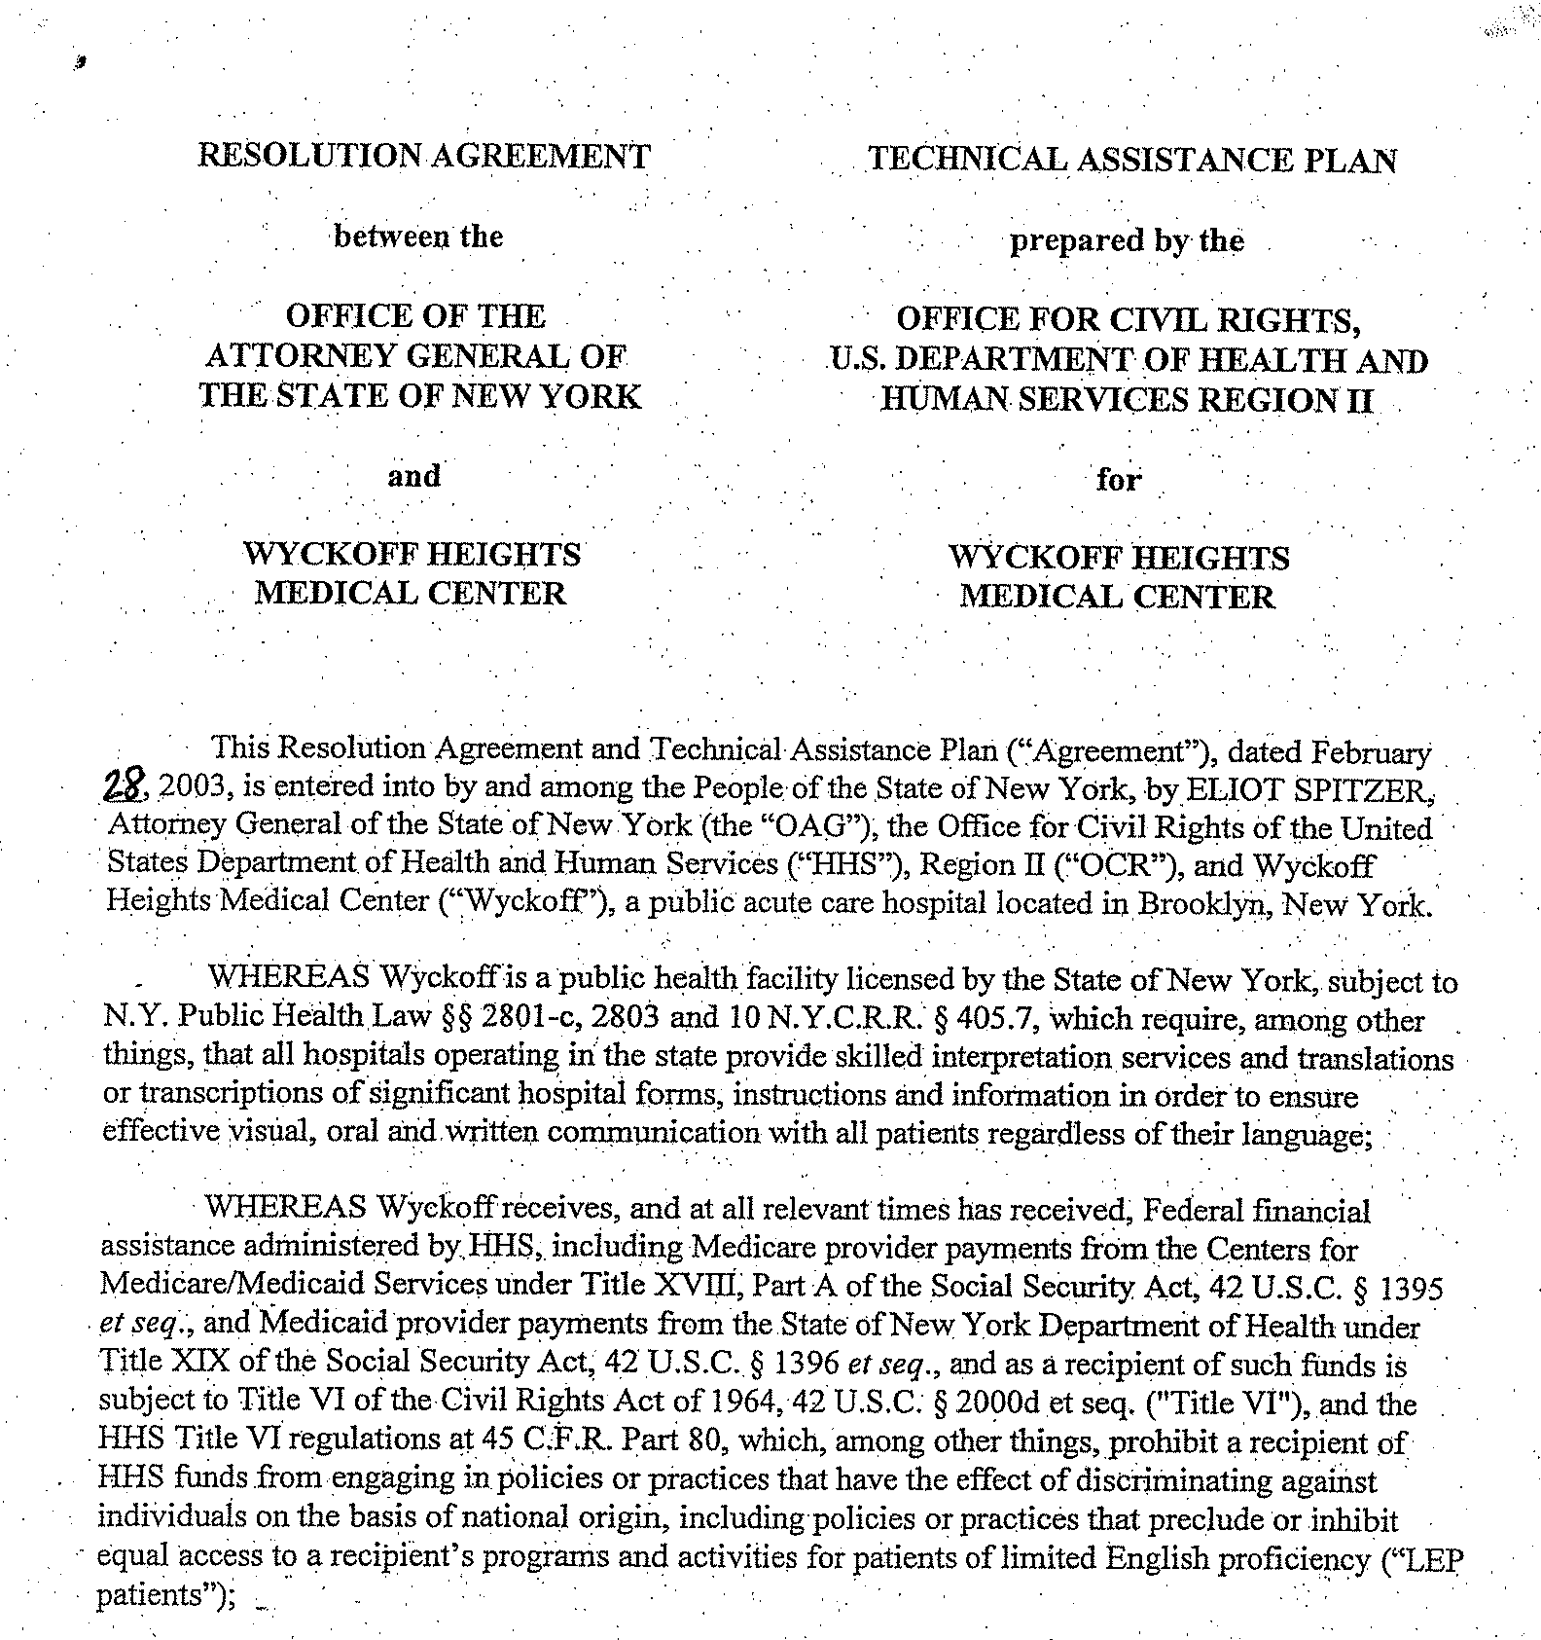
LAW AND BIOETHICS AND IMPLICIT BIAS

Slide 10
LAW AND BIOETHICS AND IMPLICIT BIAS
The role of advocacy and organizing in changing the conversation about the legal duty to address heath disparities.
Andrew Friedman

Slide 11
LAW AND BIOETHICS AND IMPLICIT BIAS
What legislation has, and has not accomplished. What more can we, and should we do?
Jorge Rivera

Slide 12
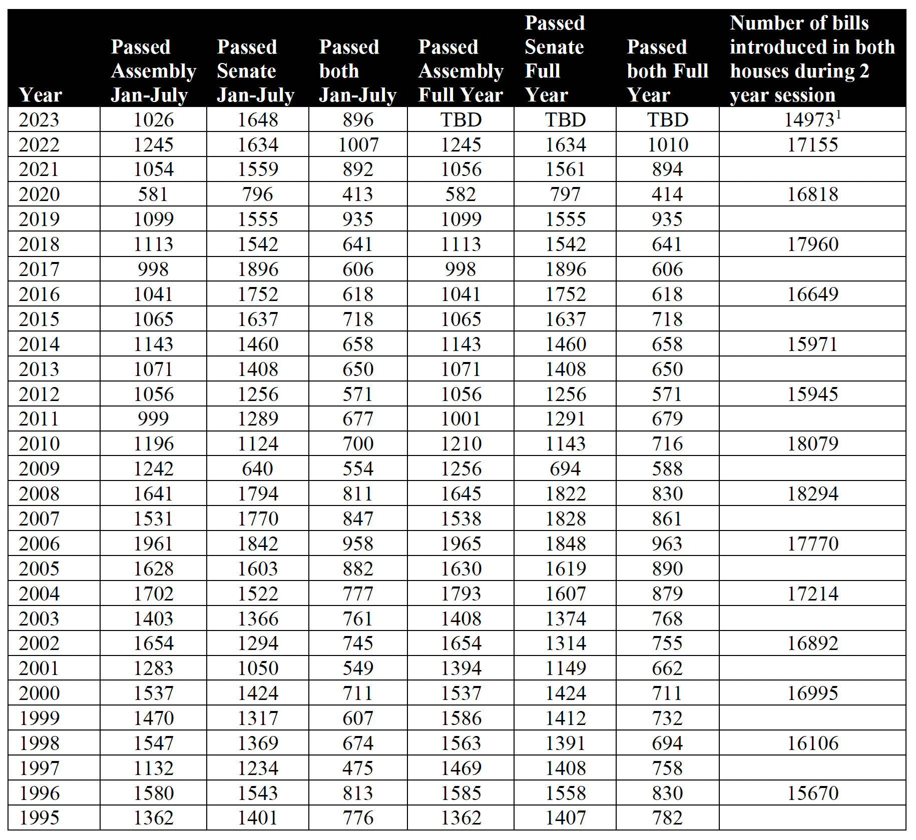
LAW AND BIOETHICS AND IMPLICIT BIAS

Slide 13
LAW AND BIOETHICS AND IMPLICIT BIAS
First participation code:

Slide 14
LAW AND BIOETHICS AND IMPLICIT BIAS
What is working, and how is it working, the interpreter’s perspective.
Tracy Koss

Slide 15
LAW AND BIOETHICS AND IMPLICIT BIAS
How does it work, and how is it not working: The Physician/Hospitalist’s perspective.
Joyeeta Dastidar

Slide 16
LAW AND BIOETHICS AND IMPLICIT BIAS
How does the hospitals’ compliance with legal and ethical obligations to provide interpretation and translation services look from the L.E.P. Patient’s perspective
Didi Sanchez

Slide 17
LAW AND BIOETHICS AND IMPLICIT BIAS
Because a picture is worth a thousand words, a short video …

Slide 18
LAW AND BIOETHICS AND IMPLICIT BIAS
Second participation code:

Slide 19
LAW AND BIOETHICS AND IMPLICIT BIAS
Panel Discussion
To what extent, if any, does the ethical obligation of clinicians to communicate effectively with LEP patients need further legal enforcement authority?

Slide 20
LAW AND BIOETHICS AND IMPLICIT BIAS
Let’s take a break for questions??????????

Slide 21
LAW AND BIOETHICS AND IMPLICIT BIAS
Next we need to consider where do we go from here.

Slide 22
LAW AND BIOETHICS AND IMPLICIT BIAS
We have the tools, now we just have to apply them to the challenge we face.

Slide 23
NEXT STEPS | Q&A
Stay tuned for part three, the technological solutions.
Q&A
PLEASE FEEL FREE TO CONTACT US IF YOU HAVE ANY QUESTIONS.
CONTACT
David N. Hoffman
DNH2101@Columbia.edu

